Slide 1
Big data analytics in the Medical domain
Huiran Liu
Roxana Tapia
Oliver Budke

Slide 2
Agenda
Project objectives (Oliver)
Medical background (Oliver)
Glossary of Terms
Influences on ABP
Preliminary Plan of Implementation
Clarification
Data Preprocessing
Feature Extraction
Training & Testing the Prediction Model
Model Evaluation
Next steps (Roxana)
Discussion / questions (Oliver) 30:00

Slide 3
Glossary of Terms
Terms | Unit of measurement | Meaning
'Time and date' | 'hh:mm:ss dd/mm/yyyy'
'HR' | 'bpm' | Heart Rate
ABPSys' | 'mmHg' | Systolic Pressure of Arterial Blood
'ABPDias' | 'mmHg' | Diastolic Pressure of Arterial Blood
'ABPMean' | 'mmHg' | Mean of Arterial Blood Pressure
'PULSE' | 'bpm'
'RESP' | 'pm' | something about Respiration
'SpO2' | '%' | Saturation of Peripheral Oxygen
'NBPSys' | 'mmHg' | Systolic Pressure of Non-invasive Blood
'NBPDias' | 'mmHg' | Diastolic Pressure of Non-invasive Blood
'NBPMean' | 'mmHg' | Mean of Non-invasive Blood Pressure

Slide 4
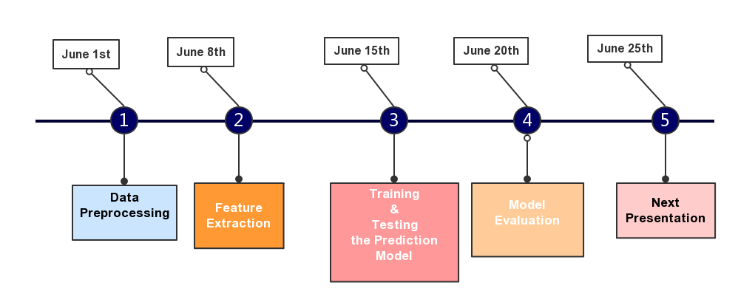
Preliminary Plan of Implementation

Slide 5
Clarification/Again
Acute Hypotensive Episode (AHE) is defined for the purposes of this challenge as any period of 30 minutes or more during which at least 90% of the MAP(ABPmean) measurements were at or below 60 mmHg.
Given Data
Target patient is adults
Forecast window: This is defined as the one-hour period immediately following a specified time T0
Wave Form Record
Numeric Record
Focus on the signal of MAP

Slide 6
Data Preprocessing
'Time and date' | 'HR' | 'ABPSys' | 'ABPDias' | 'ABPMean' | 'PULSE' | 'RESP' | 'SpO2' | 'NBPSys' | 'NBPDias' | 'NBPMean'
'hh:mm:ss dd/mm/yyyy' | 'bpm' | 'mmHg' | 'mmHg' | 'mmHg' | 'bpm' | 'pm' | '%' | 'mmHg' | 'mmHg' | 'mmHg'
'[22:01:00 29/06/2016]' | 0 | 0 | 0 | 0 | 0 | 0 | 0 | - | - | -
'[22:02:00 29/06/2016]' | 0 | 0 | 0 | 0 | 0 | 0 | 0 | - | - | -
'[22:03:00 29/06/2016]' | 0 | 0 | 0 | 0 | 0 | 28 | 0 | - | - | -
'[22:04:00 29/06/2016]' | 56.3 | 0 | 0 | 0 | 0 | 14.7 | 0 | - | - | -
'[22:05:00 29/06/2016]' | 51.6 | 0 | 0 | 0 | 0 | 12.6 | 0 | - | - | -
'[22:06:00 29/06/2016]' | 56 | 0 | 0 | 0 | 54.2 | 16.3 | 99.5 | - | - | -
'[22:07:00 29/06/2016]' | 56 | 0 | 0 | 0 | 67.3 | 16.7 | 100 | - | - | -
'[22:08:00 29/06/2016]' | 52.7 | 0 | 0 | 0 | 0 | 16.9 | 0 | 125 | 64 | 84
'[22:09:00 29/06/2016]' | 53.5 | 0 | 0 | 0 | 53.2 | 17.7 | 98.5 | - | - | -
'[22:10:00 29/06/2016]' | 53.1 | 0 | 0 | 0 | 53.1 | 16.4 | 99 | - | - | -
'[22:11:00 29/06/2016]' | 52.8 | 0 | 0 | 0 | 52.4 | 17 | 97.9 | - | - | -
'[22:12:00 29/06/2016]' | 53.8 | 135.8 | 60.4 | 87 | 53.1 | 18.2 | 97 | - | - | -
'[22:13:00 29/06/2016]' | 53.2 | 138.8 | 66.8 | 91.6 | 53 | 17.9 | 98.1 | - | - | -
'[22:14:00 29/06/2016]' | 54.1 | 0 | 0 | 0 | 53.7 | 15 | 99.2 | - | - | -
'[22:15:00 29/06/2016]' | 53.7 | 0 | 0 | 152.3 | 53.3 | 15.6 | 99.3 | - | - | -
'[22:16:00 29/06/2016]' | 51.7 | 139.7 | 67.7 | 92.3 | 53 | 15.8 | 99 | - | - | -
'[22:17:00 29/06/2016]' | 54.8 | 146.3 | 74.8 | 99 | 0 | 17.5 | 0 | - | - | -
'[22:18:00 29/06/2016]' | 58.1 | 141.5 | 71.9 | 95.9 | 0 | 17.9 | 0 | - | - | -

Slide 7
Data Preprocessing
Select 1 hour (or more) before T0
Format the date and time (no need to do this actually)
Filter the value of MAP
Higher than high arterial blood pressure (defined as >140 mmHg)
Lower than Lowest blood pressure(death or coma)
'[22:50:00 29/06/2016]' |  |  | 0
'[22:51:00 29/06/2016]' |  |  | 1
'[22:52:00 29/06/2016]' |  |  | 2
'[22:53:00 29/06/2016]' |  |  | 3
'[23:49:00 29/06/2016]' |  |  | 58
'[23:50:00 29/06/2016]' |  |  | 59

Slide 8
Preliminary Plan of Implementation

Slide 9
Feature Extraction
Linear Regression (not sure)
The wave form of MAP with 4 patients in different groups
Roxana Here ☺
Means of two clusters
Size of clusters with low value

Slide 10
Preliminary Plan of Implementation

Slide 11
Training & Testing the Prediction Model
Classification Problem
Input： The features we extracted in every patient
Labels: AHE in the forecast window occurred or not
(0,1)
Methods
SVM
Random Forest
……

Slide 12
Preliminary Plan of Implementation

Slide 13
Generalization & Model Evaluation
The goal of classification is generalization: prediction of new data
Estimate generalization performance
K-Folds Cross-validation
• Train model on part of data • Test model on other part of data • Repeat on different cross-validation folds • Average performance on test set across all folds

Slide 14
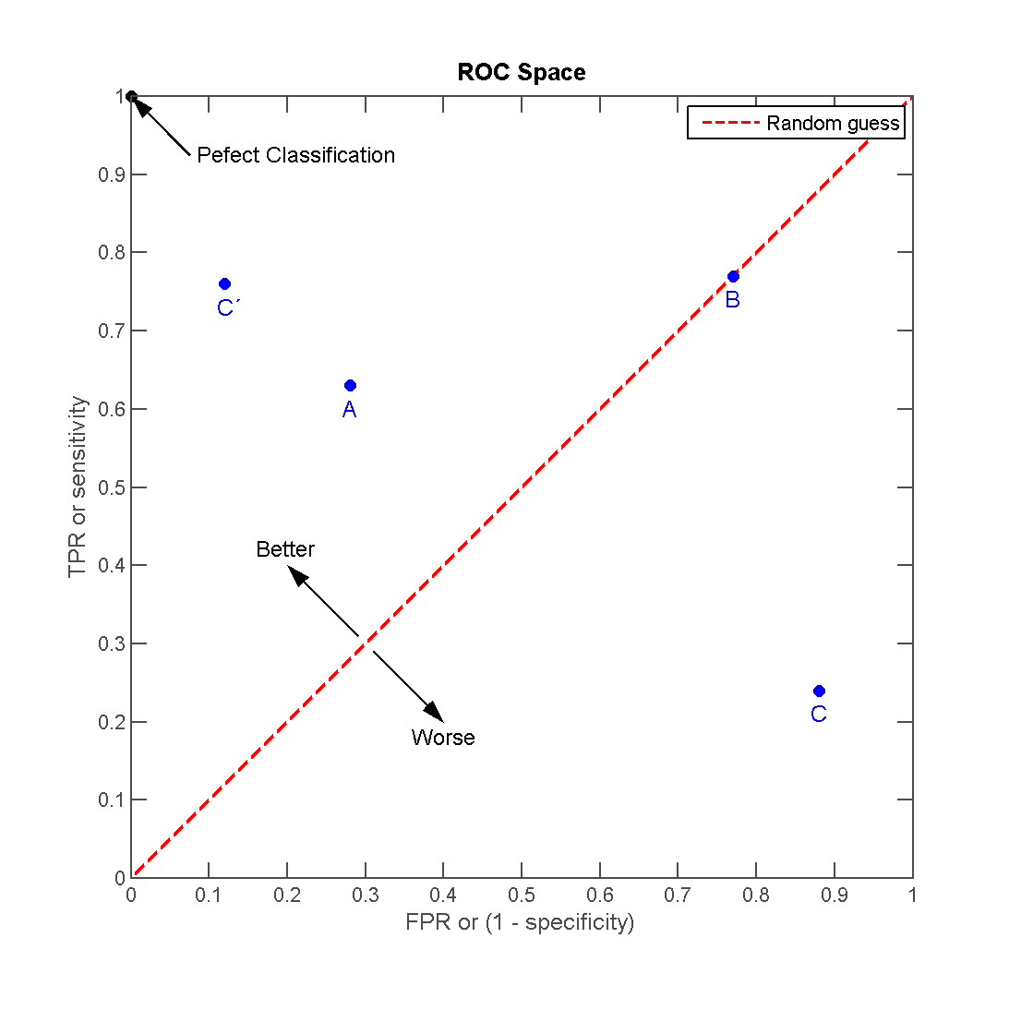
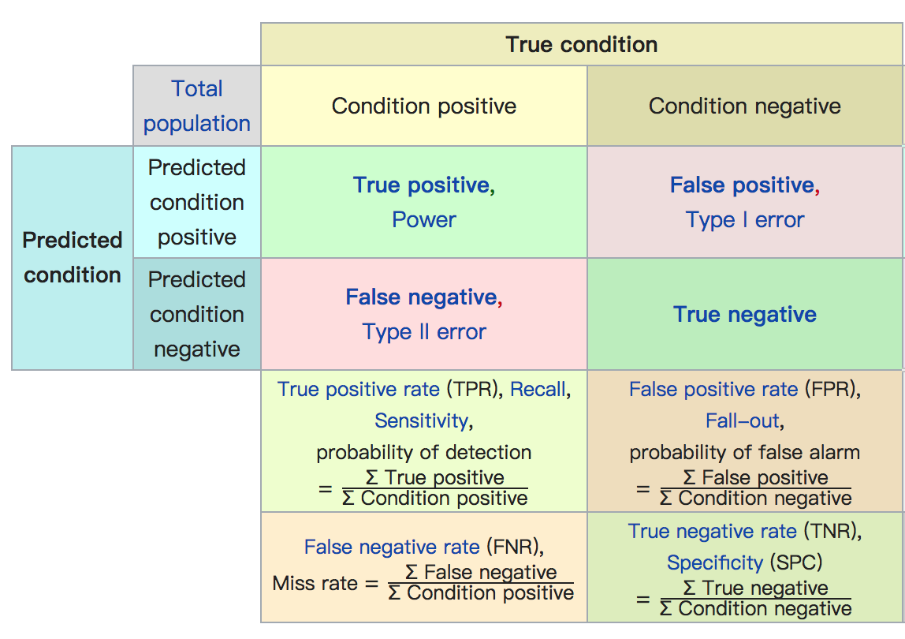
Generalization & Model Evaluation
AUC metric
Draw a ROC Curve and get the value of AUC(area under the receiver operator curve)
Confusion Matrix

Slide 15





Techniques

Slide 16
References
https://en.wikipedia.org/wiki/Blood_pressure
https://en.wikipedia.org/wiki/Receiver_operating_characteristic

